Slide 1
Before We Begin ...

Slide 2
Continuing Medical Education
CME is available for attending the webinar or watching the recording.
If you are watching in a group setting, please make sure you register for the webinar and complete the evaluation as an individual to receive CME credit.
Accreditation Statement - This activity has been planned and implemented in accordance with the accreditation requirements and policies of the Accreditation Council for Continuing Medical Education (ACCME) through the joint providership of the Federation of State Medical Boards and the Washington Medical Commission. The Federation of State Medical Boards is accredited by the ACCME to provide continuing medical education for physicians.
Credit Designation Statement - The Federation of State Medical Boards designates this live activity for a maximum of 1.0 AMA PRA Category 1 Credit™. Physicians should claim only the credit commensurate with the extent of their participation in the activity.

Slide 3
Faculty and Staff Disclosures
This webinar is not funded by any commercial entity.
As an organization accredited by the ACCME, the Federation of State Medical Boards (FSMB) requires that the content of CME activities and related materials provide balance, independence, objectivity, and scientific rigor. All faculty, planners, and others in a position to control continuing medical education content participating in an accredited continuing education activity are required to disclose all financial relationships with ineligible companies. Ineligible companies are organizations whose primary business is producing, marketing, selling, re-selling, or distributing healthcare products used by or on patients. Faculty (authors, presenters, speakers) are encouraged to provide a balanced view of therapeutic options by utilizing either generic names or other options available when utilizing trade names to ensure impartiality.
All faculty members are asked to disclose all financial relationships they have had in the past 24 months with ineligible companies regardless of the potential relevance of each relationship to the education and of the amount. The FSMB has implemented a mechanism to identify and resolve all conflicts of interest prior to the activity. The intent of this policy is to identify potential conflicts of interest so participants can form their own judgments with full disclosure of the facts. Participants will be asked to evaluate whether the speaker’s outside interests reflect a possible bias in the planning or presentation of the activity.
The speakers, course director, authors, and planners have no relevant financial relationships with ineligible companies to disclose.

Slide 4
Faculty and Staff Disclosures
The speakers, course director and planners at the Federation of State Medical Boards and Washington Medical Commission have nothing to disclose.
This educational activity may contain discussion of published and/or investigational uses of agents that are not approved by the U.S. Food and Drug Administration. For additional information about approved uses, including approved indications, contraindications, and warnings, please refer to the prescribing information for each product, or consult the Physicians’ Desk Reference.

Slide 5
Optimizing Care for People Experiencing Homelessness
LESLIE ENZIAN, MD​
ENZIAN@UW.EDU
Washington MEdical Commission
Jan 18, 2024
Notes:
I appreciate this opportunity to present today. Thank you for your interest in care for People experiencing homelessness.
I wish there were time for me to hear about your interest in this topic & how you intersect with HCH
* This work has deepened my insights into human struggle, inequity and resiliency.
I am grateful to the many pts who have shared their stories with me.
It is a luxury to work in a setting where, for the most part, I can provide indicated care, regardless of my pts’ ability to pay.
I apprec working in a state that values & supports this needed care.

Slide 6
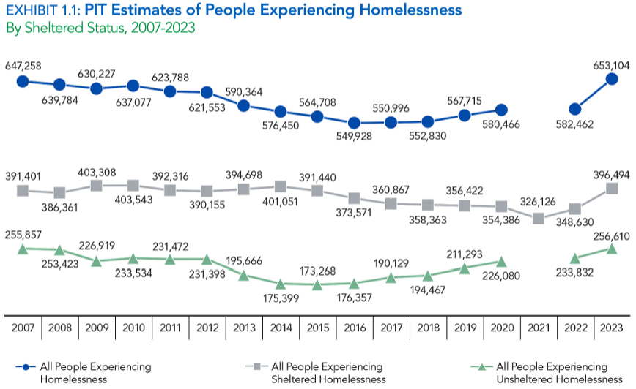
Annual Homelessness Assessment Report to Congress, 2023—National Data
Notes:
I’ll start with some demographic information.
The numbers reported of PEH can vary widely
Depends on definition of homelessness, for ex, HUD includes those in transitional housing but not those in night-to-night hotels or couch surfing …
PIT count includes those in shelters & outside 1 night of yr nationwide—misses those incarcerated, doubled, hotel, inpt, rough sleepers
Widely considered a sig underestimate but determines funding allocations.
This graph show trends in # of homeless in the U.S.since 2007 using Point in Time Count data—
Blue line representing both sheltered & unsheltered persons shows a steep 12% rise over the past year to a peak of > 650K
This was the sharpest year-to-year rise ever recorded

Slide 7
Scope of the Challenge in WA 2023
159, 533 Experiencing Homelessness
1 out of every 346 WA residents
6000 Newly Homeless in most recent month
47,000 chronically homeless (29%)
11% increase from 2022
21% rise in unsheltered homeless
Additional ~ 40,000 Unstably Housed
Receiving housing services, in transitional housing or couch surfing
Snapshot Count State Totals, 2023
Notes:
WA PIT count 2023 had 28,036
Snapshot: 3 databases tracking services of PEH, months of Jan & July
Unstably Housed includes those receiving housing services that indicate housing instability, in transitional housing or couch surfing
Chronically Homeless: Has been homeless and living as described for at least 12 months* or on at least 4 separate occasions in the last 3 years, as long as the combined occasions equal at least 12 months and each break in homelessness separating the occasions included at least 7 consecutive nights of not living as described.
Oct 2023 Eviction cases nearly doubled c/f to a yr earlier
>50% PEH are in King County

Slide 8
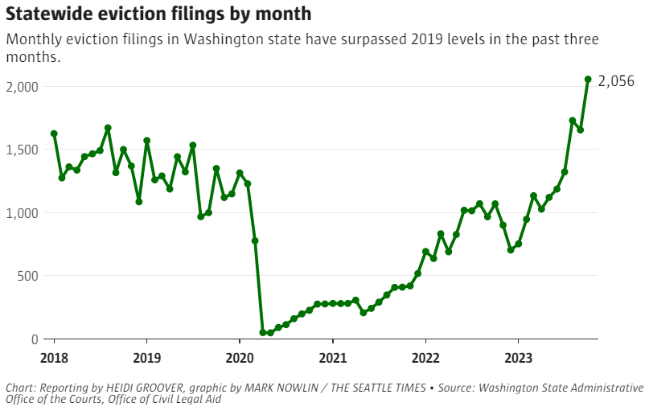
Notes:
This graph shows Evictions by month since 2018
Minimal during the pandemic eviction freeze then drastic uprise from a
Backlog of evictions
Waning $ assistance for tenants behind on their rent

Slide 9
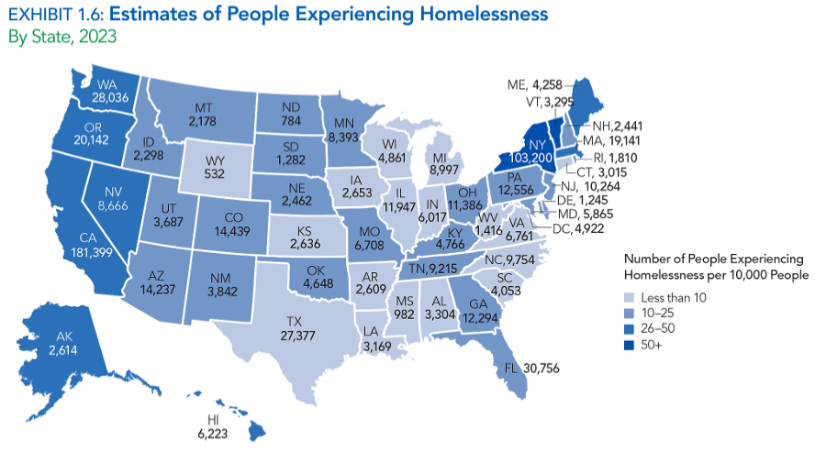
Annual Homelessness Assessment Report to Congress, 2023
Notes:
How do our numbers compare to other states?—We are on the high side
Dark blue color has the highest number (NY & VT) & we are in the next shade down
Highest #’s are Concentrated in the west & NE

Slide 10
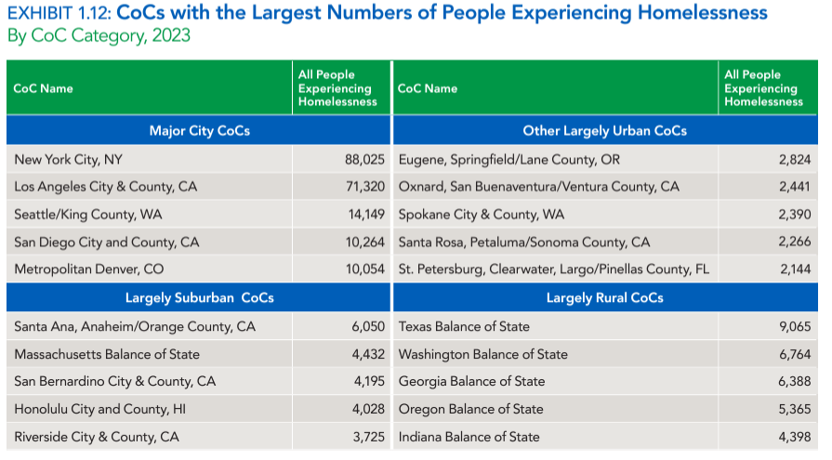
Annual Homelessness Assessment Report to Congress, 2023
Notes:
When you compare numbers from similar community sizes
The Balance of Washington State Continuum of Care (CoC) is organized to provide leadership and coordination in activities throughout its 34-county jurisdiction toward the goal of ending homelessness and working to prevent the occurrence of homelessness within the area.
BoS CoC includes jurisdictions not covered by any other CoC—includes non-metropolitan areas & may include some or all of state’s smaller clities

Slide 11
WA Race Distribution
Data from US Census Bureau and WA Dept of Commerce
Excludes mixed race or other
PEH = People Experiencing Homelessness
Notes:
There is a Disproportionate impact of homelessness on POC
In US—blacks comprise 37% of all people experiencing homelessness though represent 13% total US pop
WA Blacks 4.5% WA pop, nearly 17% of it’s homeless pop

Slide 12
Point in Time Count 2020
Notes:
When I started working at HMC in the mid 1990s, women comprised 15-25% of the homeless pop

Slide 13
2020 King County Point in Time Count
Notes:
2020 Unsheltered: --47% unsheltered– of those ~20% O/S, 20% vehicles

Slide 14
King County Point in Time Count Data
Notes:
Self-Reported Reasons for Homelessness: Job Loss, Family Disruption, Eviction or rent increase, SUD &/or MH, Illness/Hosp being key factors
2020, 21% reported some type of employment
Adverse childhood experiences

Slide 15
29 yo male, inpatient with new renal failure
Nephrotic Syndrome, Amyloidosis r/t Opioid Use Disorder
Sleeps on the streets in a tent
Requires dialysis for 4 hours, 3X/Week
Med List is long & complicated
Notes:
Unfortunately this is a very common scenario
Also large # young pts w MAP-induced severed heart failure

Slide 16
What Could Go Wrong?
Notes:
Set up for poor outcomes & high utilization
Is this pt going to get housing in near-term?
Is this pt going to get a kidney transplant?
After d/c risk of death in near-term is very high

Slide 17
Homelessness and Health
Poor Nutrition
Lack of Hygiene
Exposure to violence
Exposure to the elements
Exposure to communicable diseases
Unintentional injuries
Car vs pedestrian accidents
Complications of SUD &/or mental illness
Overdose, suicide, injuries under the influence
Notes:
Poor nutrition, meal programs lack healthy food
Violence is a constant part of life, mobility impaired vulnerable, high rates of victimization
Medical problems caused by exposure to elements Frostbite, Burns
Hard to remain clean and sober on the streets
Chronic illnesses are more prevalent/poorly controlled, assoc. with premature health decline such that geriatric health status is reached in 50’s/60’s.

Slide 18
Health Impacts
Lack of preventative & f/u care—
2-3X inc cancer/heart disease mortality (Baggett, 2013)
Chronic disease
Increased prevalence HTN, DM, COPD (Lo, West J Med 1988)
HTN, CAD, DM: Delayed Dx/more advanced/poorly controlled
Higher rates CV death at younger age (Maness, 2014)
Population is aging, 50% > 50 yo→ higher chronic disease burden (Hahn, 2006; Sorrell, 2016)
Premature/accelerated health decline:
geriatric health status in 50’s & 60’s (Brown, 2016)

Slide 19
Barriers to Care
“Homeless people face intersecting physical, mental & social burdens that greatly increase morbiDity & mortality.” (Liu; Hwang, 2021)
Notes:
Homeless people face
There are myriad barriers to accessing care
Competing priorities—shelter, food, legal req
Physiologic drive to use substances override medical appts
Sedation from substance use, compromises functionality
Med adherence
Stigma and bias
Lack of storage, theft of meds/phones
Transportation
No contact numbers, no minutes, spotty mail, limited internet access
Fear of bills
Low literacy: reading, math, health
(-) Medical Experiences/Unrealistic Tx Plans
Shame about hygiene/SUD/homelessness
No PCP
Result: Fragmented and Crisis oriented care

Slide 20
Barriers to Care
Competing priorities:
Shelter, food, jobs, legal, SUD
Lack of storage, theft of phones/meds
Transportation
No phone contacts, spotty mail, limited internet
Lack of places to recuperate or rehab
Post-hospitalization
SNF barriers: SUD, Methadone, behavior, dispo, lack training in Harm reduction & TIC
Notes:
Myriad barriers limit access to needed care for those who are homeless.
Many competing priorities of meeting basic needs
Judgmental providers, don’t feel welcome
Past experiences with providers who rec unrealistic treatment plans
Showers limited, bathtubs non-existent (sitz baths)

Slide 21
Barriers to Care
Fear of bills
Low literacy: reading, math, health
Low Provider literacy: Unrealistic Rx plans
Mistrust in care/Negative Experiences
Shame about hygiene/SUD/homelessness
No PCP
Result: Fragmented and Crisis-oriented care
Notes:
Expand on stigma
End result of all these barriers is fragmented & crisis oriented care
For
example, persons who are homeless report feeling unwelcome
in health care settings,10 and perceive discrimination from
providers because of homelessness.12 Homeless patients also
port more negative health care experiences than nonhomeless patients,13 potentially contributing to inequities in
health services use and health outcomes.1,14,15
In 2012, the Veterans Health Administrat
Wen CK, Hudak PL, Hwang SW. Homeless people’s perceptions of
welcomeness and unwelcomeness in healthcare encounters. J Gen Intern
Med. 2007;22:1011–1017.
11. O’Toole TP, Johnson EE, Redihan S, et al. Needing primary care but not
getting it: the role of trust, stigma and organizational obstacles reported by
homeless veterans. J Health Care Poor Underserved. 2015;26:1019–1031.
12. Skosireva A, O’Campo P, Zerger S, et al. Different faces of
discrimination: perceived discrimination among homeless adults with
mental illness in healthcare settings. BMC HealthServ Res. 2014;14:376.
13. Jones AL, Hausmann LRM, Haas GL, et al. A national evaluation of
homeless and nonhomeless veterans’ experiences with primary care.
Psychol Serv. 2017;14:174–183.

Slide 22
Medications
Decreased medication adherence
Cognitive/MH/SUD impairments
Pt. Reasons cited: Side effects, cost, lack of Rx provider (Hunter, 2015)
Medication side effects more difficult to manage
dry mouth (water fountains scarce)
polyuria, diarrhea (toilets hard to find)
over sedation (increased vulnerability)
Notes:
Treatment plans have to be Grounded in reality

Slide 23
29-yo male with renal failure continued
Doesn’t take diuretic (toilets & H2O scarce)
Scabies identified at dialysis—Rx before returning
Addiction: Prioritizes securing substances
Has to dose at methadone before morning HD
Partial runs & missed dialysis sessions
Readmitted to hospital with CHF & severe hyperkalemia requiring urgent dialysis
Notes:
Common Clinical scenario

Slide 24
Homelessness & Mortality
Age-Adjusted Mortality Rate 3-4X general population
Unsheltered mortality 3X higher than sheltered & 10X higher than general Massachusetts population (Roncarati, et al, 2018)
> 50% attributable to tobacco, alcohol & drug use
Cancer and heart disease predominant causes among older individuals (Baggett, et al, 2013)
Average lifespan 42-52 yrs old (Jones, 2009, Lee, 2005)
King County 2009-2019, Mean age at death 48.9 (compared to WA life expectancy of 80.3 years)
Boston mean age at death: 51 (Baggett et al 2012)
Notes:
* The Health impacts are reflected in an . . .
Studies in Boston, NY, Phil have all supported this fact
Boston: those living unsheltered . . .
mort sig higher even when control for SUD factors
Any other prevalent diagnosis with mortality rates such as this would be perceived & responded to as a public health crisis
* literature—longer one remains unsheltered & w/o access to care, more likely premature death occurs
Deaths Among Presumed Homeless Jan 2012 – Dec 2021
Limited to KCME Data. Only unexpected, violent, suspicious &/or lack of known cause of death are investigated
1,429 deaths presumed homeless (5% of all investigated deaths
60% occurred outdoors, in vehicles or other spaces not meant for human habitation
Median age 51 yo (62 yo for KCMEO decedents, 79 yo for all KC residents)

Slide 25
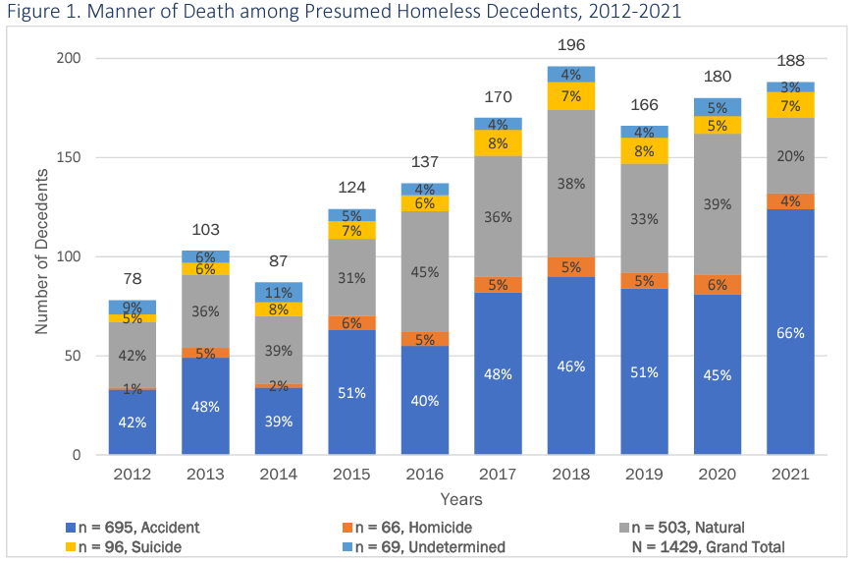
Seattle King-County PHD Report On Deaths, 2022
Notes:
Over 10 yrs, accidents account for largest proportion of deaths
71% accidental deaths drug OD & poisoning cases, (35% deaths overall)
13% accidental deaths = traffic deaths—large # car vs peds
35% natural deaths

Slide 26
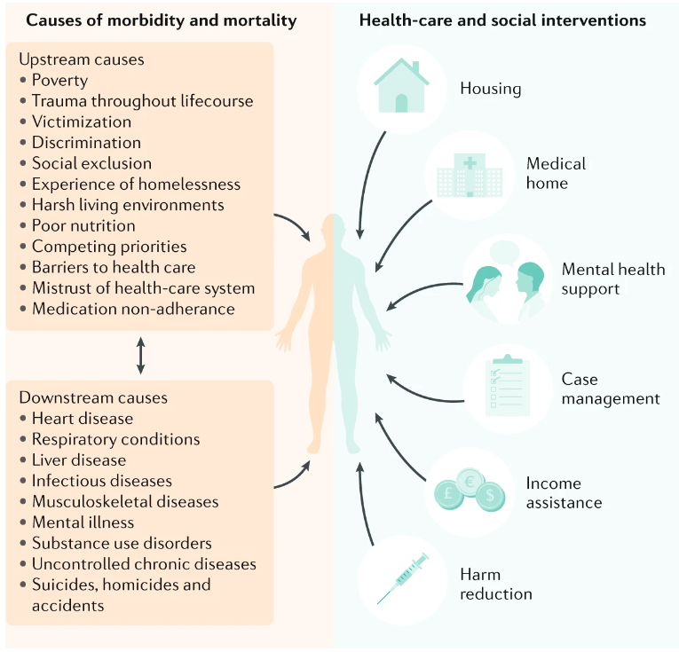
Lui, Nature, 2021

Slide 27
Homelessness & Utilization
Increased ED & inpatient utilization
Increased Length of Stay
Increased readmissions
Extreme utilization outliers
Notable increase in health care costs
Notes:
* Million dollar Murray The New Yorker, tracked care, cost taxpayers $1 million/10 yrs

Slide 28
Common Problems
Dental Disease
Complications to substance use
Skin/soft tissue
Infections
Burns
Mechanical Problems
Friction: Ulcers, corns/calluses-ill-fitting shoes/ambulatory lifestyle
Venous stasis +/- ulcers
Prolonged walking/standing/sitting, Sleeping upright
Vein damage from IV Drug Use
PE from prolonged sitting in car seat
Exposure-related conditions
Immersion foot (trench foot), Frostbite, hypothermia
Notes:
Skin & ST problems very common esp involving feet #
Often infrequent oppor to remove/change socks/shoes/reliance on shared shower facilities, inc risk fungal infections
Burns very common—ex propane used for cooking/heat & tent catches on fire, relatively common story is pt who uses opioids falling asleep w/ arm on heater
There are Problems related to the mechanics of living homeless
Ambulatory lifestyle & ill-fitting shoes result in Friction blisters, ulcers
Esp problematic w/ neuropathic feet from DM or EtOH where dec sensation means skin trauma can’t be felt and may not be noticed in a timely fashion
Ex huge wound pt did not even feel
Just as prolonged sitting on long bus/plane trips can cause DVTs that result in PEs,
the same happens to those living out of their cars with possessions piled everywhere except the driver’s seat such that sleep sitting up

Slide 29
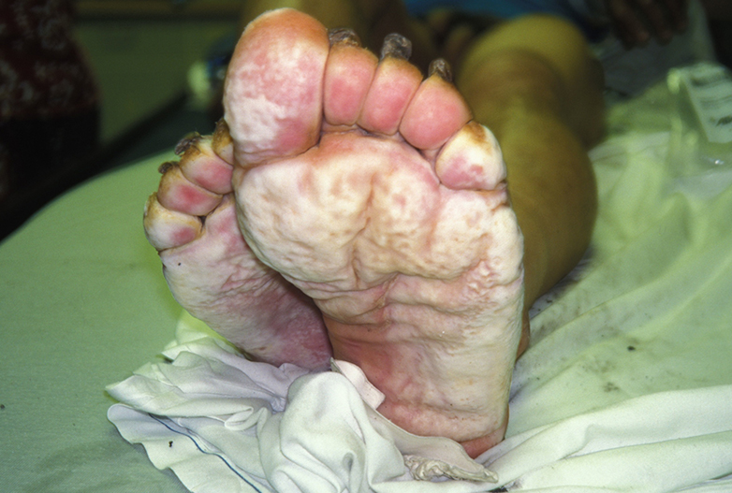
Immersion Foot
UpToDate2021
Notes:
Immersion/Trench Foot
Wet macerated skin

Slide 30
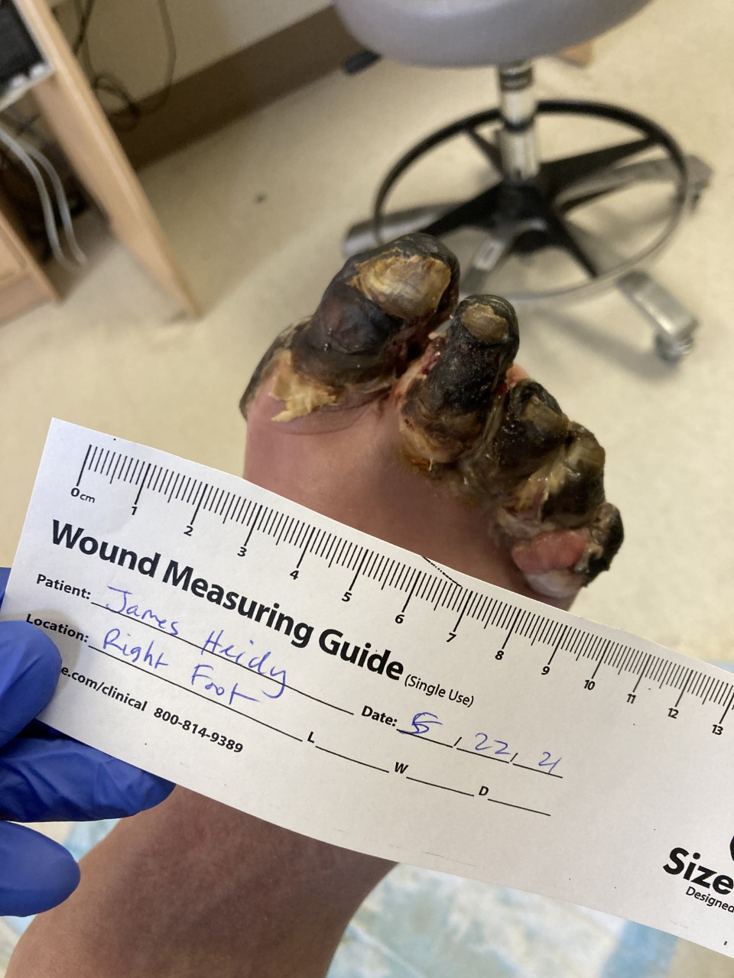
Notes:
Case of frostbite managed at respite
Numerous cases every year, even in milder winters
Feet get wet in the rain, maybe they are sticking outside of the blankets, often underlying PAD w/ poor perfusion, dehydration, neuropathic numbness or not removing shoes delays presentation

Slide 31
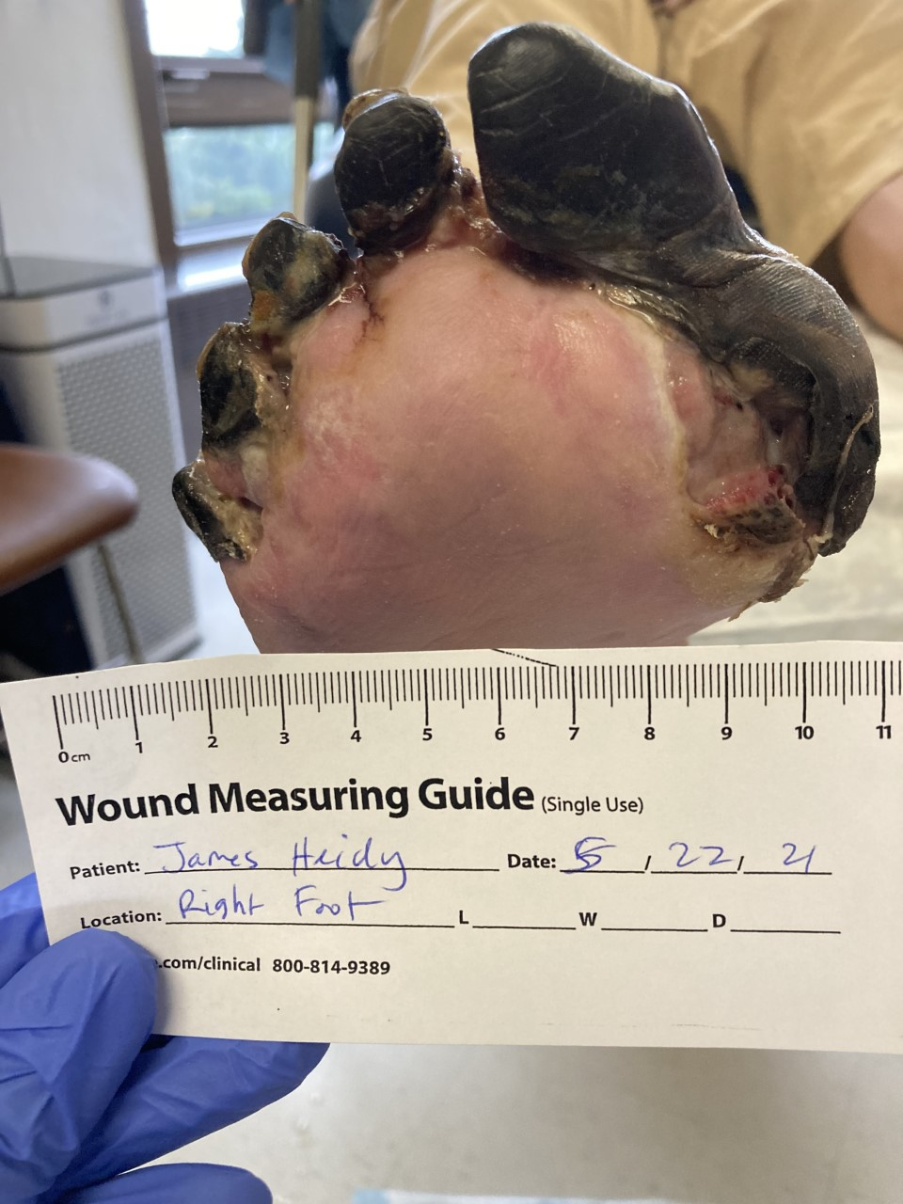
Notes:
Pt thought he was previously a surgeon & would heal fine, declined amputation
Referred to APS for self-neglect, somehow triggered him in the system
Call that pt’s bro had died and pt was due to inherit~ $500K
Past 30 yrs family thought pt was dead, registered him as deceased
(Needs payee)

Slide 32
Infectious Diseases
Bacterial infections:
cellulitis, respiratory tract infections, IVDU-Assoc
Communicable Diseases:
HIV 3-11% in population (homelessness assoc w/ decreased viral suppression)
Viral Hepatitis
Enteritis: norovirus, shigella outbreaks
Syphilis and other STIs
TB:
> 40% risk contracting (Fazel, 2014),
many present w/ advanced disease
Infestations: Scabies, lice, bed bugs
Notes:
TB Rates > 40X higher. (Fazel, 2014 Lancet)
& many present w/ advanced dz
lice vectors for Bartonella Quintana, bac infection assoc w/ septic arthritis and endocarditis

Slide 33
Cognitive Conditions
Cognitive & Functional Impairment Homeless adults > 50 yo (Brown, 2012)
24% MMS score < 24,
1/3 difficulty w/ at least 1 ADL,
> half fallen in past year
Traumatic Brain Injury
Prevalence ~ 50% (Topolovec-Vranic, 2014)
annual incidence 18-19% (Nikoo, 2017)
Risk Factor for remaining homeless
Notes:
Often not recognized, inpt pts are in bed urinal at bedside, nurse administers meds
Once these pts come to respite where they are not staying in bed
Can’t find their room, can’t manage their meds, s/t ADL deficits (usu ask for PT/OT evals before accepting)
Pts w/ Cog impairment & TBI very much fall through the cracks
Case mgmt programs specifically for pts w/ MH and SUDs, don’t accept pts w/ primary problem of cog d/o
AFHs & SNFs often don’t accept pts living homeless or have h/o SUD
& generally don’t have experience in TIC and don’t follow HR philosophies such that the pts leave or are asked to leave
TBI 38-53% (topolovoc-Vranic, 2012), TBI risk factor for becoming and remaining homeless (topolovoc,
w/ aging, incidence of age-related conditions inc cog impairment and fxn decline in homeless pop has increased, fazell, 2014 lancet

Slide 34
Mental Illness
Estimates vary; prevalence high & outcomes worse
Higher Adverse Childhood Experiences (ACE) scores
Severe MH: 10-20X inc risk of homelessness (Gabrielian, 2021)
Homelessness, even temporary, is a toxic stressor
sustained impacts on physical & mental health compared to never homeless (Oppenheimer, 2016)
Notes:
Homelessness not just housing instability but also potential interruptions of employment, education, health care & psychosocial fxn
MH and SUD both inc risk of and are exacerbated by homelessness
HOW MANY FEEL FAIRLY FAMILIAR WITH THE CONCEPT OF TRAUMA INFORMED CARE?

Slide 35
Successful Models
Low-barrier access
walk-in capacity at primary medical home
One-stop health care clinic
Pharm, nutrition, podiatry, psych, SW, clothing, DME
Integrated multidisciplinary team care
Embedded and outreach services
Collaborative care with Safety Net
Time for care coordination & advocacy
Harm-reduction philosophy
Trauma-informed approach
Rebuild trust in health care
Housing First approach
Notes:
Take the time to advocate/refer connect w/ network/refer—Case management
Advocacy—joint replacement, dialysis (health literacy)
TIC: Rebuild trust in health care system
Sensitive to physical/emotional boundaries
Anticipate unexpected triggers, don’t personalize negative responses
Allow patient to dictate pace of visits, assessments
Seek permission during physical exam & care,
Offer safe use counseling
Shame → Reluctance around exam, use normalizing language (decayed teeth, malodorous feet) “I see all kinds of teeth, it doesn’t bother me”

Slide 36
Housing = Health Care
“Health, health care & housing are inextricably linked.”
(Lui; Hwang, 2021)
Notes:
Bears mentioning
Inadequate Housing Supply & Process Barriers
COVID
Asking who is helping pt w/ housing—steer towards housing case mgr

Slide 37
Realistic Treatment Plans
Anticipate possibility of poor follow up
Case mgr/peer navigator escorts
Outreach teams
Multiday dressings
Diabetes
May need loose BG control to avoid dangerous lows
Nutrition education in context of available food
Regular diet inpatient?
Insulin pens, reading glasses, glucose gel/tabs
Notes:
Navigating care needs requires creativity, thinking o/s the box to manage unique situations not previously encountered
Individualized care plans—insulin OD—daily dose in clinic, pre-fill syringes for staff at housing, dose dilantin daily, not dose wkends, higher dose during the week
Dance in the grey—decision-making
Case manager escorts, possible future peer navigators
SW at Primary care clinic—warm hand-off
Temper expectations

Slide 38
Medication Strategies
Intentional strategizing to optimize med adherence
Simplify—once daily if possible
Set phone alarms for dosing
Mediset fills or teaching or Blister packs
Consider side effect management
Avoiding meds requiring monitoring
Start med independence inpatient
Be aware of misused medications
Clonidine, gabapentin, Phenergan potentiates opioid effects and are sold on the streets
Notes:
There needs to be intentional strategizing to optimize med adherence
blister packs, RN mediset fills, on-site med admin

Slide 39
Tips for Care
Ask specifics about sleeping location
> 50 yo—consider functional & cognitive impairment screening
Ask about literacy and tailor teaching & plan
Ask about h/o TBI with Loss of Consciousness
Look at the feet & teeth (normalizing language)
Trial runs before hospital discharge: Remove urinal, have pt manage meds
Address non-acute issues w/ episodic care
Screening: Viral, TB, diabetes, cancer
Vaccinate
Notes:
1st Have to work to rebuild pt trust in health care system
Living homeless not sufficiently informative, where sleeping, how long stay, how long been w/o housing
#
Feet: Normalize if embarrassed about feet/mouth
Non-acute
½ Hep A vaccines 95% effective
OD prevention and ask Do you inject or smoke, use alone or not, if pt agrees to counseling, offer safer injection techniques, tips to avoid OD
TBI screening for h/o brain injury w/ LOC > 30 minutes, LOC w/I past 6 mo, apparent or reported cognitive impairment during interview
Screening tests along with acute care, clear plan for follow up of results (visit if no phone), partner w/ patients to determine order and priority
50/> cognition, incontinence, falls

Slide 40
Trauma Informed Care
Recognizes the prevalence of adverse childhood experiences/trauma among all people
Assumes individual more likely than not has a trauma history
Recognizes many behaviors and symptoms are the result of experiencing and coping with trauma
Shifts the question from “What’s wrong with you?” to “What has happened to you?”
Notes:
TIC approach rec

Slide 41
Trauma Informed Care Approach
Respect, kindness
Support control, choice, autonomy
Use strengths-focused perspective to promote resilience
Can improve patient engagement
Secondary Trauma to healthcare workers
Burnout Prevention
Maintain perspective when plans fail
Prioritize self-care

Slide 42
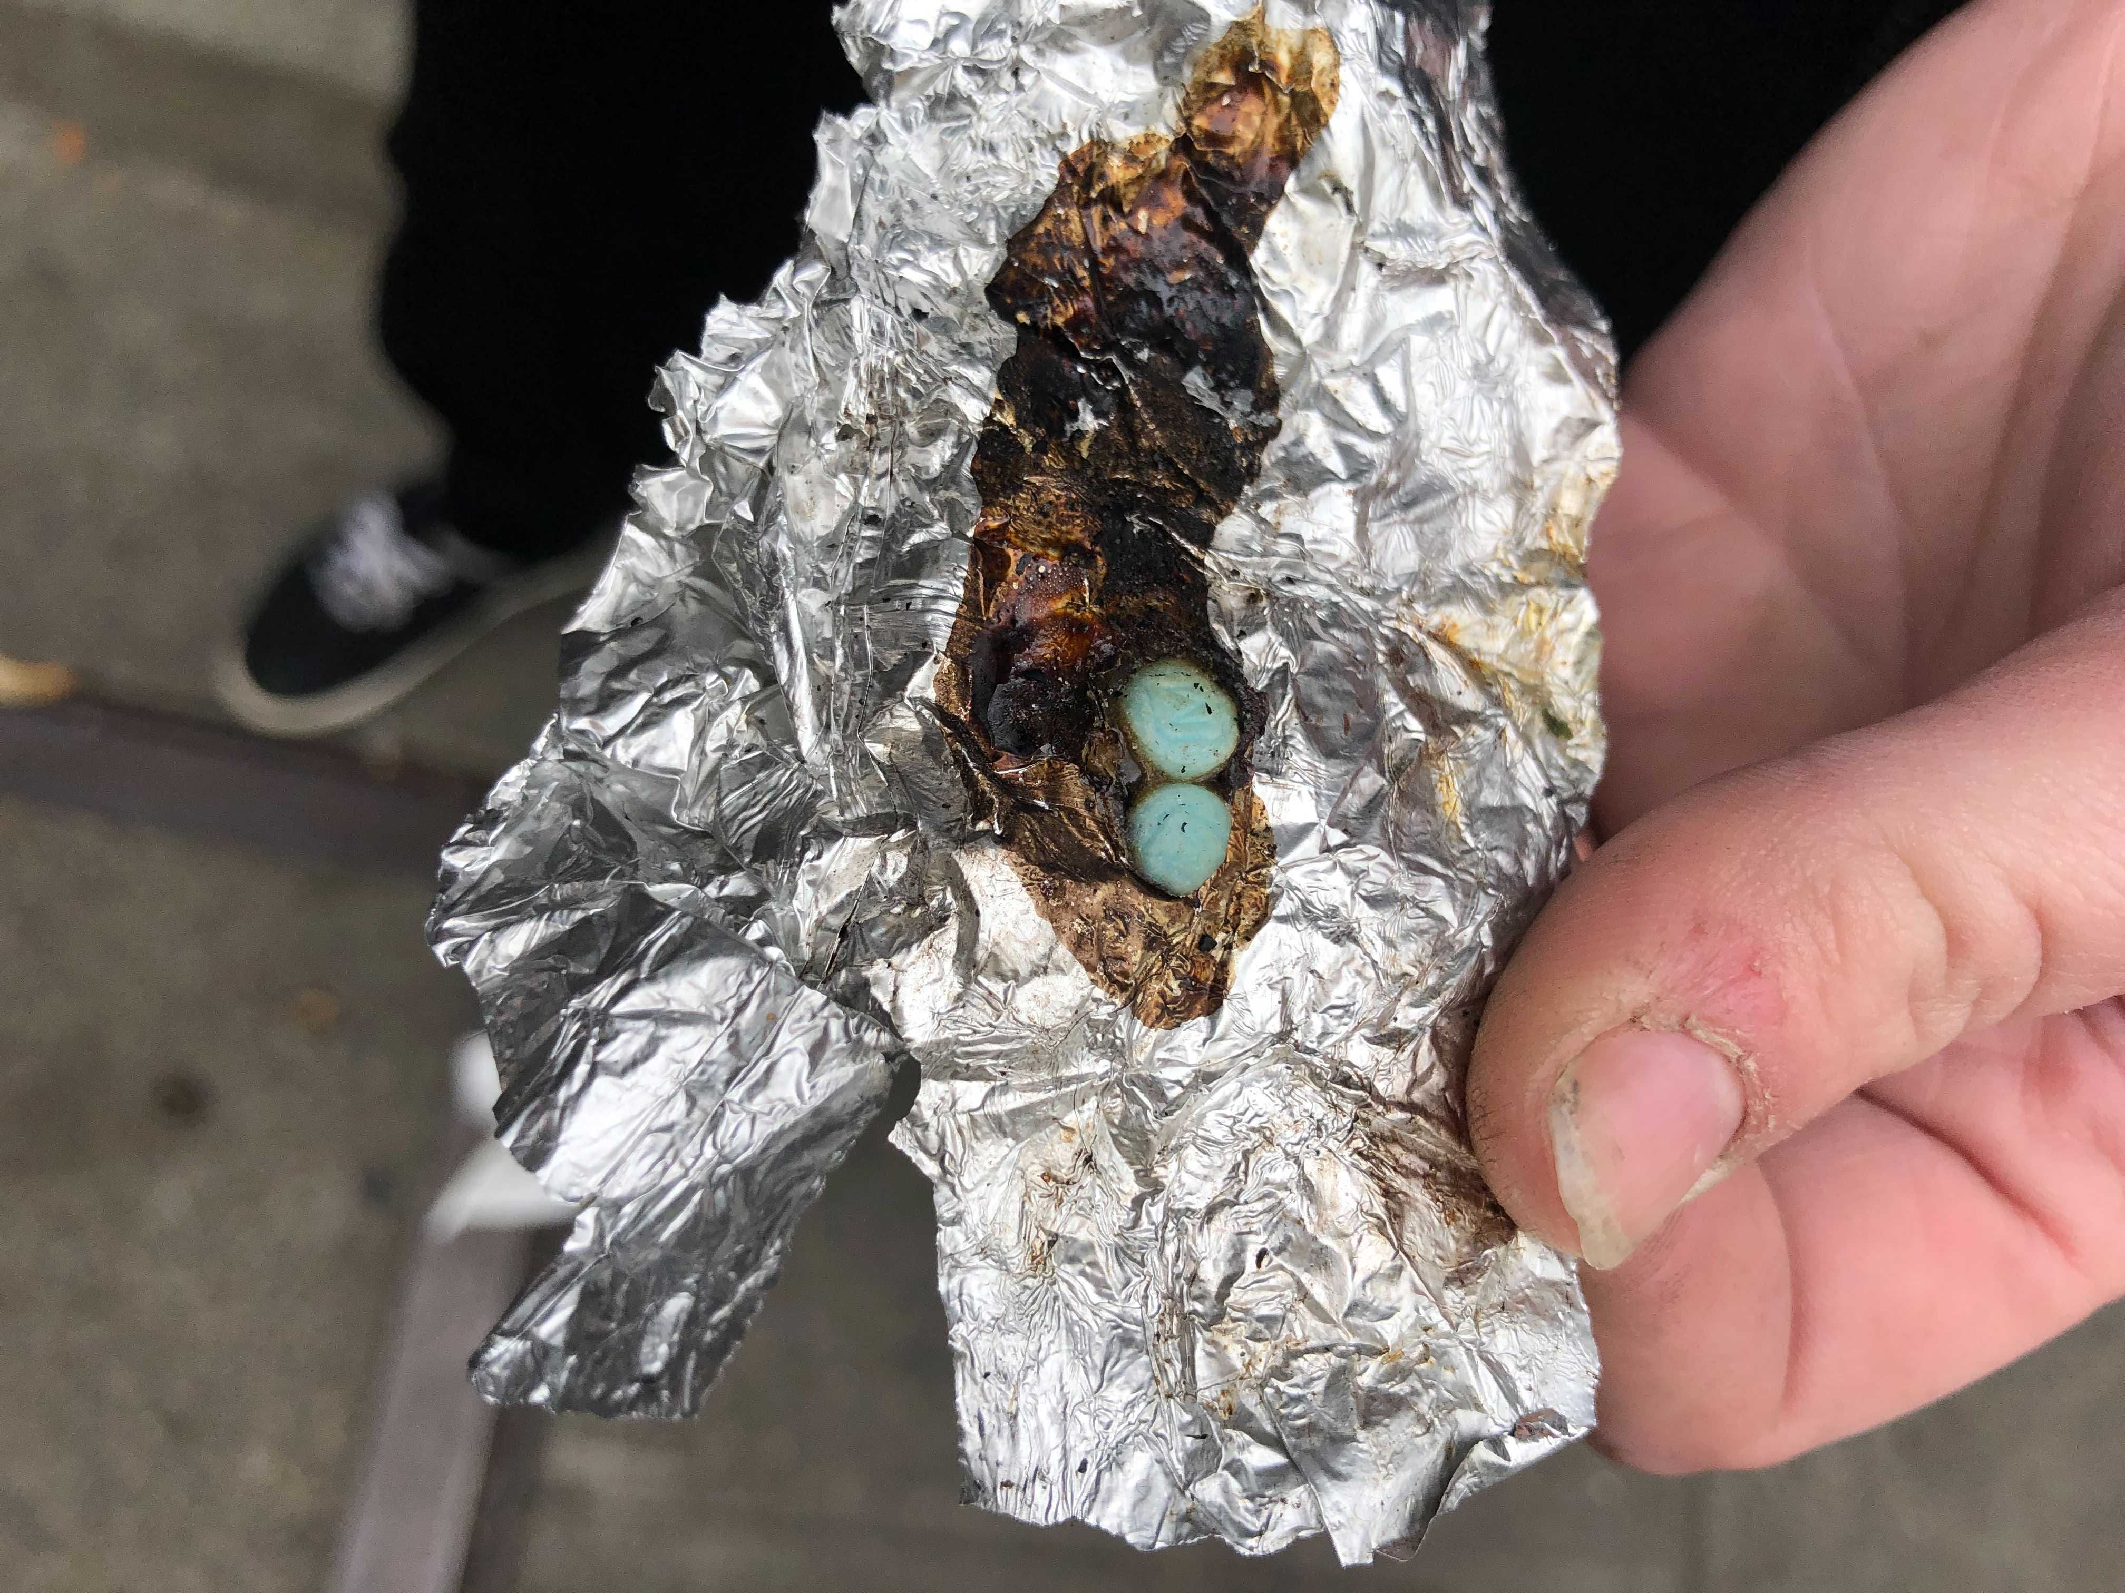
Notes:
SUD can lead to homelessness & vv

Slide 43
What is Harm Reduction?
Programs, Policies & Practices that Aim to:
Reduce the adverse health, social and economic consequences of substance use
Without, necessarily, reducing drug consumption
Social Justice movement based on belief in & respect for the Rights of PWUD (HarmReduction.org)
Set of non-judgmental approaches aiming to provide or enhance skills, knowledge, resources & support people need to live safer, healthier lives (Streetworks, 2000)
IHRA, 2010

Slide 44
Pragmatism
SUDs are Prevalent
2019: 20.4 mill adults
Does not include those who did not engage in SUD Rx in past year
> 50% those living homeless actively using substances (Lebrun-Harris, 2013)
Most (90%) don’t receive treatment
Treatment resources don’t meet the need
Many don’t perceive a need for treatment (SAMSHA 2020)
Addiction is a chronic, relapsing condition; abstinence often temporary
SAMSHA, 2020; Surgeon Gen. Report, 2016
Notes:
Realistic acceptance that drug use is part of our works
Chooses to work to minimize harmful effects, rather than ignoring or condemning the behavior
Relationship SU & homelessness is bidirectional: SUD may ppt homelessness, rigors of street-life may cause or perpetuate SUD, also self-medicate Psych

Slide 45
Abstinence Approach: Limited Efficacy & Appeal
Mean 16 lifetime abstinence-based attempts in chronically homeless w/ AUD (Drucker, 2016)
95% w/ lived experience of homelessness preferred non-abstinence based goals (Collins, 2019)
Treatment engagement decreased as program demands—esp abstinence, increased (Collins, 2015)
Many prefer moderation goals, even after successfully completing abstinence-based treatment (Blume, 2013)
Notes:
Return to WHEEL after that—Client-Centered, Nonjudgemental
Addiction is chronic, relapsing disease

Slide 46
Lowered Harm = Success
Does not minimize/ignore real & tragic harm & dangers of SUD
Some ways of using are safer than others
Functional improvements achieved w/o abstinence
Reduce negative consequences
optimize QOL
Societal, population, community, individual level harm reduction
Notes:
No contradiction b/t prevention/Rx & decreasing adverse health & social consequences—false dichotomy. Complementary

Slide 47
Overdose Prevention
Notes:
OD prevention: Narcan
Reverse motion detectors
Explicit conversations to discuss safer use practices
Do you inject or smoke? Consider smoking?
Every inject in neck/groin? Discuss assoc risks.
Do you reuse your needles or cottons?
Do you use alone?

Slide 48
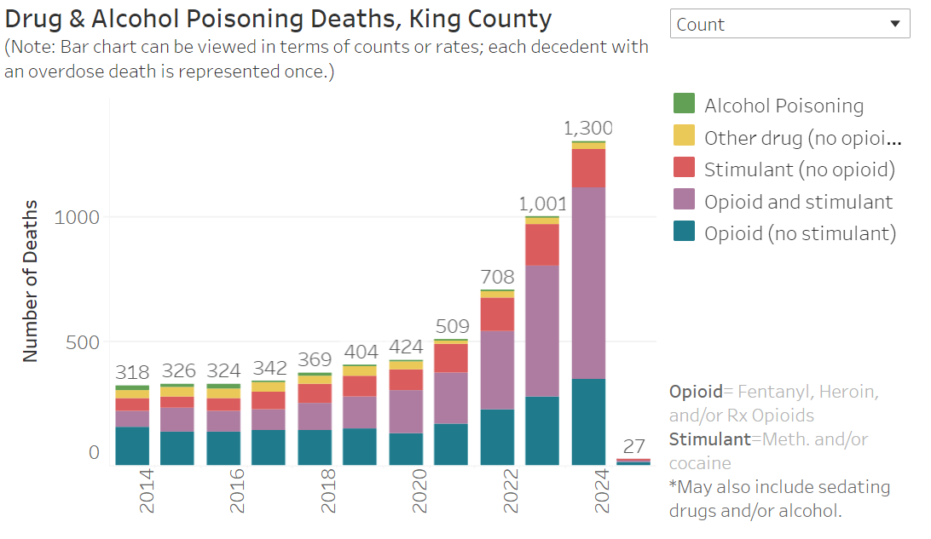
Kingcounty.gov overdose data dashboard

Slide 50
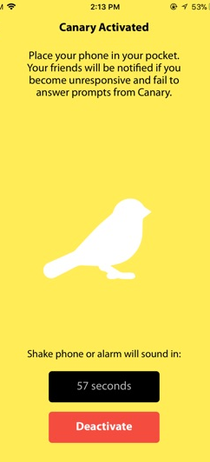
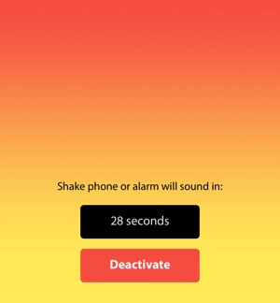
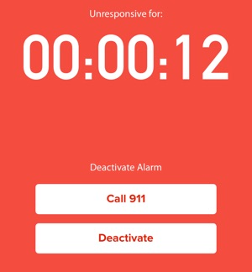
OD Prevention Canary App

Slide 51
Stigma and SUD
Socially objectionable conduct while under the influence or in withdrawal perceived as deliberate
Personal choice & moral failing, not medical disease
Impacts compounded by internalized stigma/shame
Structural stigma in criminalization, adds to burden
Leads to bias, marginalization, risky practices, care avoidance, delayed presentation, decreased access, decreased quality of care, worse outcomes
PWID 1/3 did not seek care due to fear of mistreatment
Reinforces underinvestment in treatment resources
(Volkow, 2021 & 2022, Kennedy-Hendricks, 2017, Rivera, 2012, Biancarelli, 2019, McGinty, 2020, Bearnot, 2019, Meyersen, 2020)
Notes:
Overcome w/ intention, effort & willpower
medical providers harbor same stigmatized perceptions
Not exclusive

Slide 52
Words Matter
STIGMATIZING/CREATES RISK OF BIAS | ALTERNATIVE LANGUAGE
Homeless female | 60 year-old female experiencing homelessness/living homeless
IV Drug User (or alcoholic, meth addict) | Person who injects drugs (PWID) (drinks alcohol/ smokes MAP)
"Dirty" urine | Urine drug test was positive for cocaine
Clean and sober for 8 years | has not used alcohol for 8 years
Opioid abuse/addiction/dependence | Opioid use, Opioid use disorder
Illicit drugs | purchased drugs from community/street sources
Patient tampered with his PICC line | Patient accessed his PICC line
Patient refused/Noncompliant/Nonadherant | Patient declined/does not consistently take meds
Diabetic/Asthmatic | Person living with diabetes/asthma
HIV (+) male/female | males/female living with HIV
wheel-chair bound/handicapped/disabled/special needs | mobilizes with a wheelchair, person with a disability
Victim of sexual violence, sexually abused female | Survivor of sexual violence
Mentally ill patient, schizophrenic male | Has a history of schizophrenia
Suffering from | Living with
Convict | Person who served time in jail for a crime
Sex trade worker | Person who works in sex trade/exchanges sex for $
Amputee | Person with an amputated leg
Style-Guide-for-Inclusive-Language_Dec-2017.pdf (dcfpi.org)
Notes:
* The words we choose can perpetuate bias and stigma
* Stigmatizing language has infiltrated standard medical speak and this language influences how we view and care for patients.
If we individually model alternative language then, collectively, we can contribute to a shift in our health-care culture. This is necessary & important work
Even though I have been in this business for decades, sometimes, stigmatizing terms that have been engrained pop out of my mouth
We should avoid defining/labeling patients by their diagnoses or behaviors
& avoid painting ourselves as saviors of vulnerable or incapable patients.
People living homeless demonstrate incredible perseverance and resiliency
put together a chart w/ some examples and suggestions for alternative phrasing #

Slide 53
Tackling Stigma
Person-1st Language
Emphasizing solutions: Rx options, OD prevention
Sympathetic Narratives that humanize
Emphasize societal rather than individual causes
Promote understanding of behavioral consequences of use
Include those w/ lived experience in planning, services & as peer navigators
McGinty, NEJM, 2020 -- Volkow, NEJM, 2020
Notes:
Lack of adequate studies—needed!—these approaches demonstrated impacts
Nuances—pregnant F, SUD, hi SES sympathy, not if low SES

Slide 54
Words Matter
STIGMATIZING/CREATES RISK OF BIAS | ALTERNATIVE LANGUAGE
homeless female | 60 yo F experiencing homelessness/living homeless
IV Drug User (or alcoholic, meth addict) | Person who injects drugs (PWID) (drinks alcohol/ smokes MAP)
"Dirty" urine | Urine drug test was positive for cocaine
Clean and sober for 8 years | has not used alcohol for 8 years
Opioid abuse/addiction/dependence | Opioid use, Opioid use disorder
Illicit drugs | purchased drugs from community/street sources
Patient tampered with his PICC line | Patient accessed his PICC line
Patient refused/Noncompliant/Non-adherant | Patient declined/does not consistently take meds
Diabetic/Asthmatic/High Utilizer | Person living w/ DM/asthma/4 inpt stays in past 6 mo
HIV (+) male/female | males/female living with HIV
w/c-bound/handicapped/disabled/special needs | mobilizes w/ a wheelchair, person with a disability
Victim of sexual violence, sexually abused female | Survivor of sexual violence
Mentally ill patient, schizophrenic male | Has a history of schizophrenia
Suffering from | Living with
Convict | Person who served time in jail for a crime
Sex trade worker | Person who works in sex trade/exchanges sex for $
Style-Guide-for-Inclusive-Language_Dec-2017.pdf (dcfpi.org)
Additional Resource:
Notes:
* The words we choose can perpetuate bias and stigma
* Stigmatizing language has infiltrated standard medical speak and influences how we view and care for patients.
If we individually model alternative language then, collectively, we can contribute to a shift in our health-care culture.
This is important work and, even though I have been in this business for decades, occasionally, stigmatizing terms that have been engrained pop out of my mouth
We should avoid defining/labeling patients by their diagnoses or behaviors—identity is a person
& avoid painting ourselves as saviors of vulnerable or incapable patients.
People living homeless are demonstrate incredible perseverance and resiliency

Slide 55
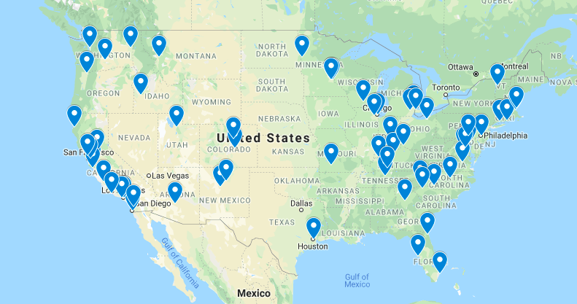
Medical Respite Programs

Slide 56
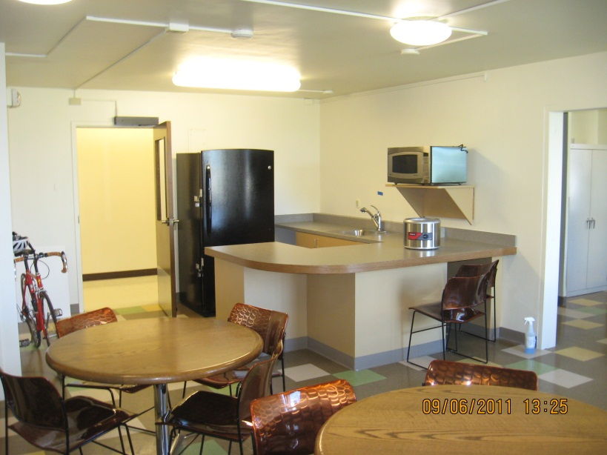
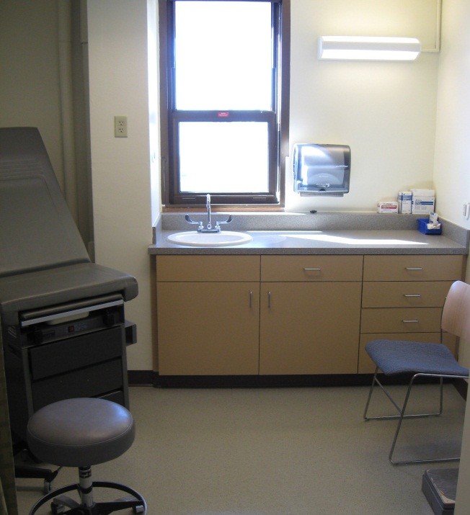
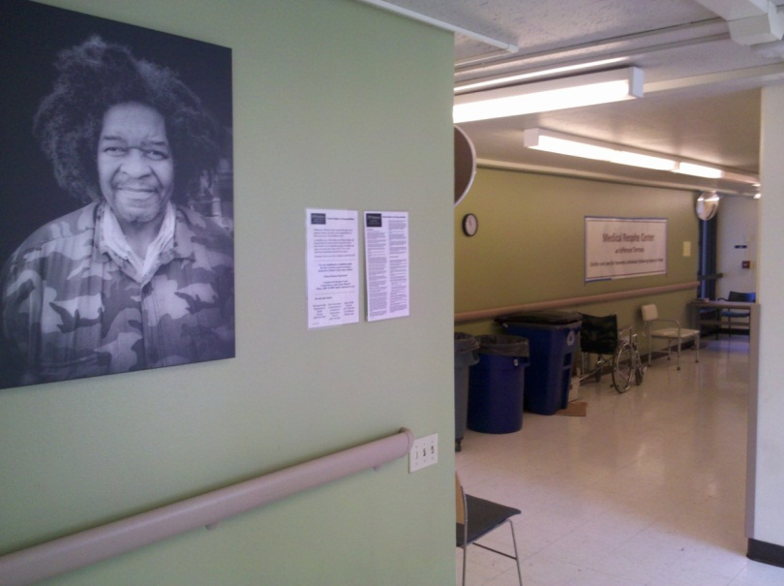
Edward Thomas House Medical Respite Program
Common areas
3 exam rooms
Notes:
35-bed facility
Opened in shelter 1996
Patients were frequently d/c for substance use w/ unresolved medical issues—complications & readmissions
2011 became a free-standing program allowed us to fully integrate a harm-reduction approach
Multiple respite programs in WA—Yakima, Pierce county
Respite care currently billable service
Essential, start small & develop over time
56

Slide 57
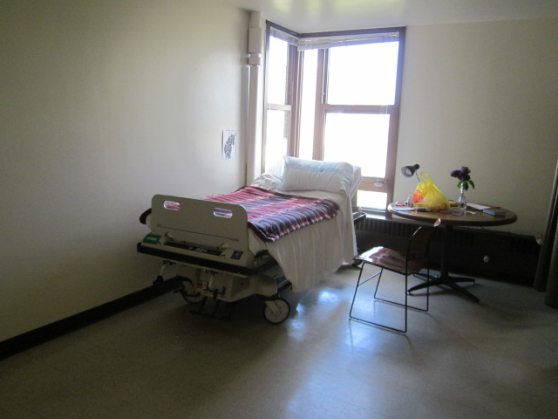
34 beds, 3 beds/room + BR, 4 handicapped rooms (12 beds)
Notes:
Coed

Slide 58
Medical Respite Services
Short-term care for acute illnesses/injuries
Goals:
Resolution of Acute Process
Window of opportunity for long-term impacts
Decrease Utilization
Services
RN & Provider care
Case management (MH, SUD, dispo planning)
Establish Medical Home
Connect to long-term services

Slide 59
Respite Admissions
Wounds: Abscesses, ulcers, frostbite, burns, post-op
Extended Antibiotics (IV and Oral)
Endocarditis, epidural abscesses, septic arthritis
Cancer Rx: Radiation/Chemotherapy
Hospice/Palliative Care
Elective procedures
Colonoscopy, ambulatory surgery
Notes:
Avoid redundancy strive to fill existing service gaps
Wounds from abscesses, burns, ulcers, post-op wounds
Avoid chronic wounds, chance to heal with appropriate care, ARNP/RN certified wound care specialists

Slide 60
Respite Admissions You Might Not Think of
Diagnostic evaluation if disenfranchised
High Utilization Admissions
ED to Respite direct admits (prioritized)
Clinic to respite (averted admission)
SNF to Respite Protocol

Slide 61
29-yo M, new renal failure Viable Interventions
Admit to Medical Respite to support dialysis transition
Support independence in medication management
Stabilize on medications for opioid use disorder
If methadone, advocate for carries/delivery
Connect to outreach case manager
Connect to Homeless Palliative Care team
Facilitate engagement with a primary care provider
Care coordination with dialysis SW
Secure a telephone
Transition to a shelter with embedded medical support
Notes:
This pt scenario is commonly encountered
HPC—outreach for pts w/ life-limiting conditions
We Care methadone
Ex pt who arrived DNR w/o plans for no HD

Slide 62
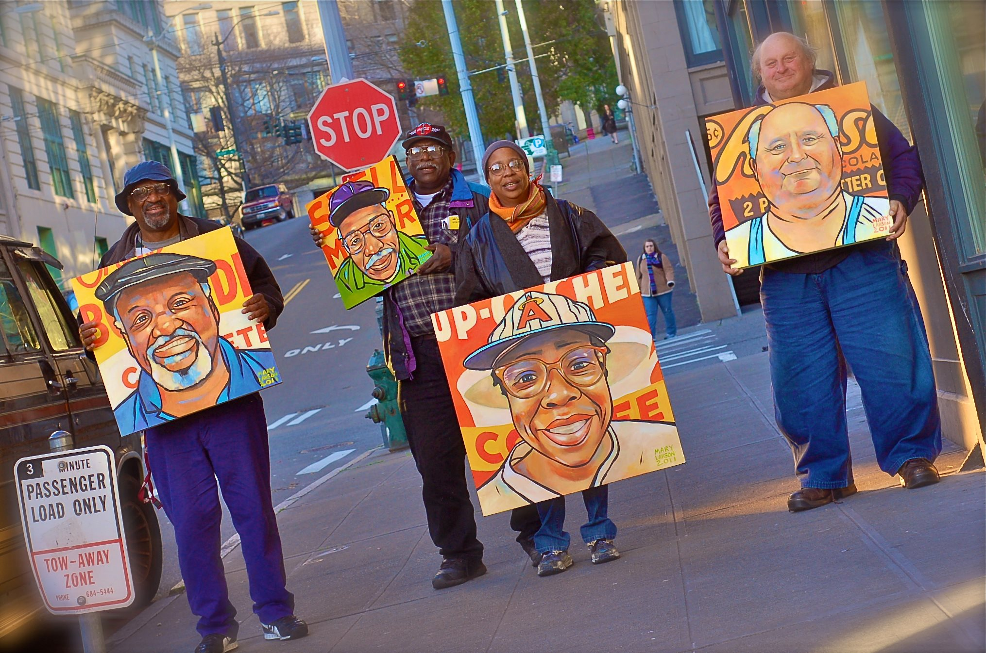

Slide 63
Resources
Adapted Clinical Guidelines | National Health Care for the Homeless Council (nhchc.org)
Guidelines available for DM, asthma, TBI, end of life care and more
Health Care for Homeless Women | ACOG
Harm reduction resources for safer use:
https://depts.washington.edu/harrtlab/resources/
Trauma Informed Care

Slide 64
Additional Slides for Reference

Slide 65
Attributable Inpatient Costs
Length of Stay: Prospective, controlled admin data, n > 90,000 (Hwang, 2011)
+ $2559/inpatient admit
Med/Surg patients: > inpt days w/o acute care needs
Discharge Delays: Urban Safety Net Hospital (Feigal, 2014)
Mean discharge delay 8 days vs 4 days for controls
Higher rates of Pt Directed Discharges (aka AMA) (Saab, et al, 2016)
Readmission Rate (Doran, 2013)
30 d readmission rate: 50.8%
70.3% readmit to ED/Inpt/Obs status
74.8% readmissions within 2 wks of discharge
Notes:
* Once hospitalized, costs are also sig higher
mostly accounted for by more overstay days when pts did not require inpt care
(Doran) Retrospective review evaluated readmission rates

Slide 66
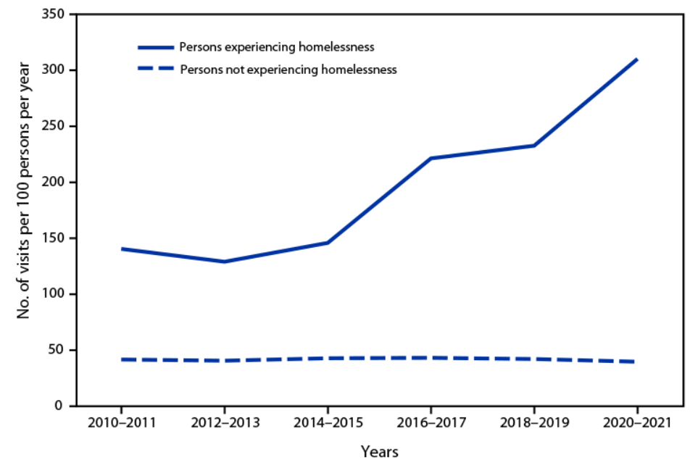
MMWR Morb Mortal Wkly Rep 2023;72:115, Rate of ED Visits by Homeless Status
Notes:
ED Visits

Slide 67
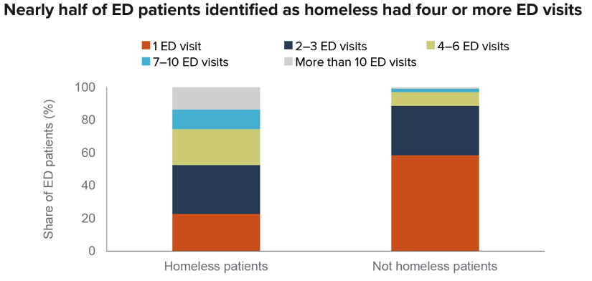
McConville, 2022 from CA Health Care Access & Information hospital discharge data, 2019

Slide 68
Medical Utilization 1,165 insured homeless vs 1,165 controls Matched age, sex, low-income, 4.3 years
Utilization | Homeless
Single Men ED Visits | 9.2 X higher
Single Women ED visits | 13.3 X higher
Single Men Hosp. Rates | 5.4 X higher
Single Women Hosp. Rates | 4.8 X higher
Average Costs | Homeless | Non-Homeless Controls
ED $/yr/person | $5725 | $1500
Annual Hospital $ | $6.67 million | $1.75 million
Hwang, 2013
Hwang, 2013
Notes:
Not only is homelessness assoc with poor health outcomes, it has a substantial impact on healthcare costs.
Prospective controlled trial over 4 yrs on utilization
Compared to their matched controls

Slide 69
Utilization Outliers More Prevalent and Extreme
Utilization | Homeless | Likelihood of visit or admit
Max ED Visits/person-yr | 104.9 | 55.65 X
Max Admits/person-yr | 14.9 | 55.84 X
Hwang, 2013
Notes:
A subset analysis revealed Utilization outliers far more prevalent & extreme
Million Dollar Murray

Slide 70
Harborview Homeless Data
20.6% of medicine ward discharges
Length of Stay Housed vs Unhoused
Medicine Ward: 9.5 vs 12 days
Surgery : 10.5 vs 15.8 days
Neurology: 8.2 vs 24.3 days
30-Day readmit rate, medicine service: 30% (older data)
>3 admits/yr

