Slide 1
2025 Legislative Session: Post Mortem
WMC May 7, 2025
Micah Matthews, Deputy Executive
and Legislative Director
Stephanie Mason,
Public Information Officer and Legislative Liaison

Slide 2
WMC and Session Involvement
The Washington Medical Commission is the state regulator for allopathic physicians and physician assistants.
The WMC does not lobby or have a political action committee (PAC).
The WMC does actively participate in the legislative session.
The goals of the Washington Medical Commission (WMC) during the legislative session are:
  To protect the public by ensuring quality healthcare is provided by physicians and physician assistants.
  To ensure practitioners have the legal and regulatory infrastructure to provide quality health care to Washington citizens.
Notes:
Hello, I’m Micah Matthews, the WMC Deputy Executive and Legislative Director as you can see from the intro slide. Our contact information will also be on the last slide for you.
Each year, we give two presentations—one at the start of the legislative session and one at the end—to share an overview of the key issues we encountered. A big part of our goal is to explain who we are and how we’re involved in the legislative process.
The Washington Medical Commission (WMC) licenses and regulates about 35,000 healthcare practitioners. We're overseen by 21 Commissioners appointed by the Governor and supported by a staff of 64, including a legislative team of four (soon to be five).
Our role in legislation and rulemaking is to uphold medical standards, promote patient safety, and protect the integrity of medical practice

Slide 3
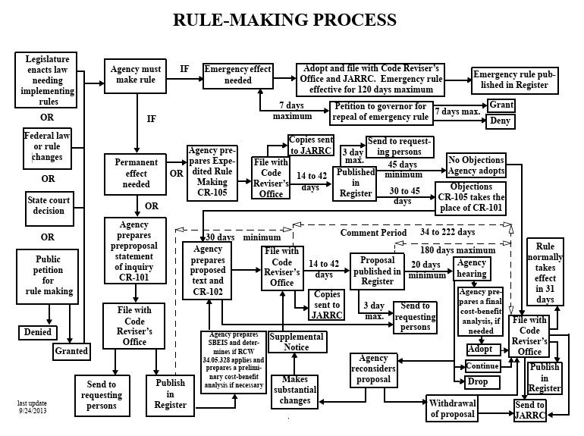
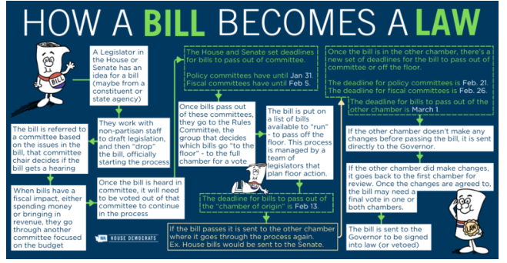
Laws and Regulations
Washington State Laws (Statutes)
Creation: Enacted by the Washington State Legislature and signed by the Governor.
Compilation: Codified in the Revised Code of Washington (RCW).
Function: Establish broad policies and frameworks for governance.
Rulemaking (Administrative Regulations)
Authority: State agencies derive rulemaking authority from enabling statutes passed by the Legislature.
Compilation: Rules are codified in the Washington Administrative Code (WAC).
Function: Provide detailed procedures and requirements to implement and enforce statutes.
Notes:
During session the WMC tracks, monitors, and analyzes bills. We are an independent agency and work collaboratively with the Department of Health. The WMC testifies on bills, meets with legislators and helps educate stakeholders and the public on legislation that is beneficial or detrimental to the practice of medicine.
Additionally, the WMC takes part in the rulemaking process. These rules become part of the Washington Administrative Code (WAC), or simply WAC. Oftentimes rulemaking is included as instruction for the WMC in legislation.

Slide 4
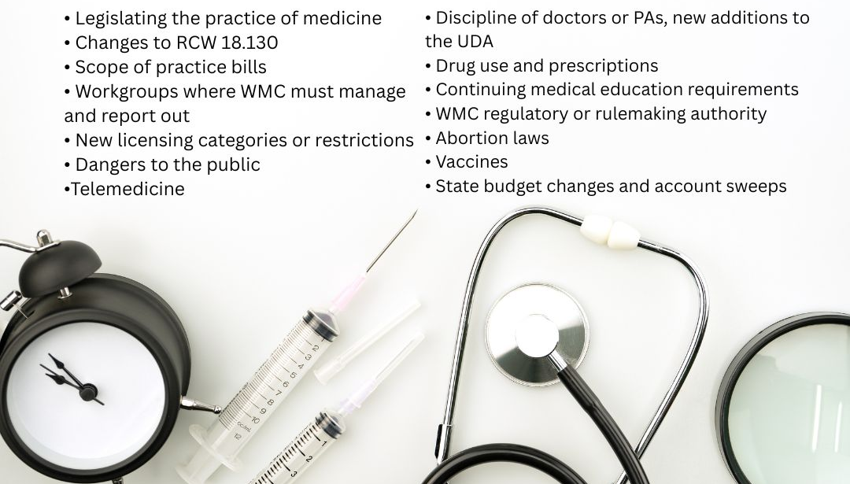
Concepts that the WMC tracks
Notes:
This is a broad overview of the types of issues we track each session.
The Medical Commission may testify on one of these concepts. Especially if it is legislation that
directly affects our practice act;
directly requires the Medical Commission be responsible for enacting some part of the legislation;
or could negatively impact the practice of medicine or the public.
Most of these listed are self explanatory. We find that the legislature sometimes attempts to intervene in the practice of medicine, often by attempting to mandate actions or education that should be left to the professional judgment of healthcare practitioners.
The last issue listed here, the budget, was especially impactful this year as the state has a huge budget shortfall.

Slide 5






2025 Legislative Leadership
Senator Annette Cleveland
Senator
Manka
Dhingra
Senator
June
Robinson
Representative Timm Ormsby
Representative Dan Bronoske
Notes:
This session also saw new leadership at both a Federal and State level. We were prepared to see an uptick in the number of bills introduced that focused on reproductive and transgender health. However, that was not the case.
Most important policy committees for the medical commission - the place where bills start for us - are:
• Health care & Wellness committee in the House, which has 15 members.
• Health & Long term care committee in the Senate, which has 12 members.
The WMC continued to foster a good working relationship with the chair of the Senate Health Committee Annette Cleveland and worked to create a new relationship with House Health Chair, Representative Dan Bronoske (Brawn ah ski) who was a big help in the passage of our UDA tech fix.
Also of importance is the 9 member - Senate Law & Justice Committee which is chaired by Senator Dhingra. This committee was responsible for the passage of our reproductive fraud bill in 2024.
And last but never least the fiscal committees House Appropriations which is chaired by Representative Timm Ormsby
Senate Ways and Means which is chaired by Senator June Robinson,

Slide 6
2024 and 2025 Bills
To look up bills visit : leg.wa.gov
2024
HB 1300 – Assisted reproduction fraud
HB 1917 – PA Compact
HB 1972 – Physicians health program fees
HB 2041 – PA Practice
SB 5184 – Anesthesiologist assistants
SB 5481 – Uniform telehealth act
SB 5821 – Audio-only telemedicine
2025
HB 1640 – UDA Tech Fix
HB 1718 - Concerning well-being programs for certain health care professionals
SB 5632 - Confidentiality of records and information (Sheild law)
SSB 5118 - International medical grads
ESSB 5557 –EMTALA/ Pregnancy Treatment
Notes:
Last year the WMC tracked 63 bills internally, and over a hundred collaboratively with the Department of Health and we shared just a handful in this presentation.
This year’s legislative session was notably different from previous years. While the medical commission tracked roughly 50 bills internally; only 10 of those bills made it to the Governors desk. The Department of Health tracked 27 bills but did extensive analysis on each to equal over 257 bill analysis. Unlike past years, the legislative website is not predicting to have stats for this session until June. In previous years the numbers of bill introductions has been over a 1,000 and some sessions over 2000. Our guess is that there was a significant reduction in bills overall.
The Governor’s office significantly limited the number of bills introduced, largely due to a substantial budget deficit. Every decision, analysis, and recommendation we made was weighed carefully, knowing that each carried potential impacts. It was a challenging session by any measure.

Slide 7
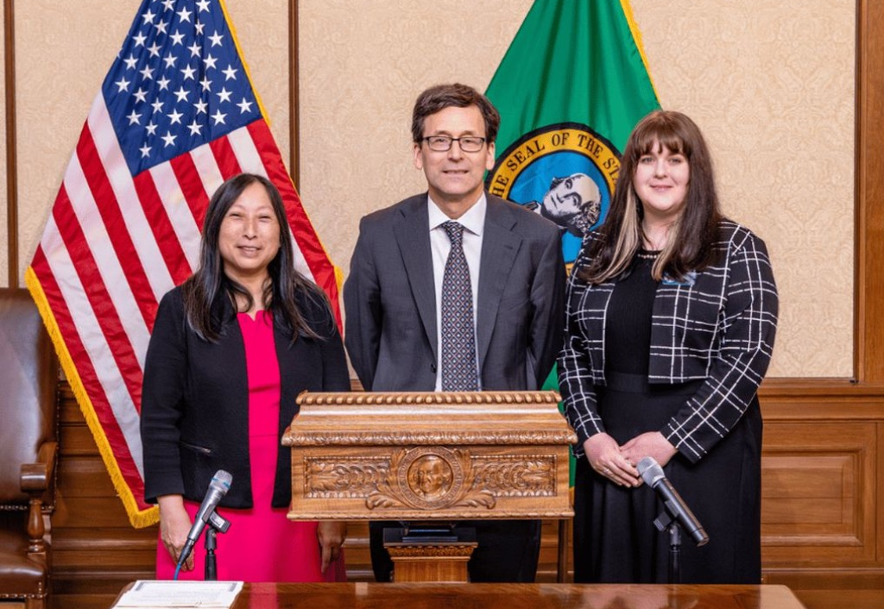
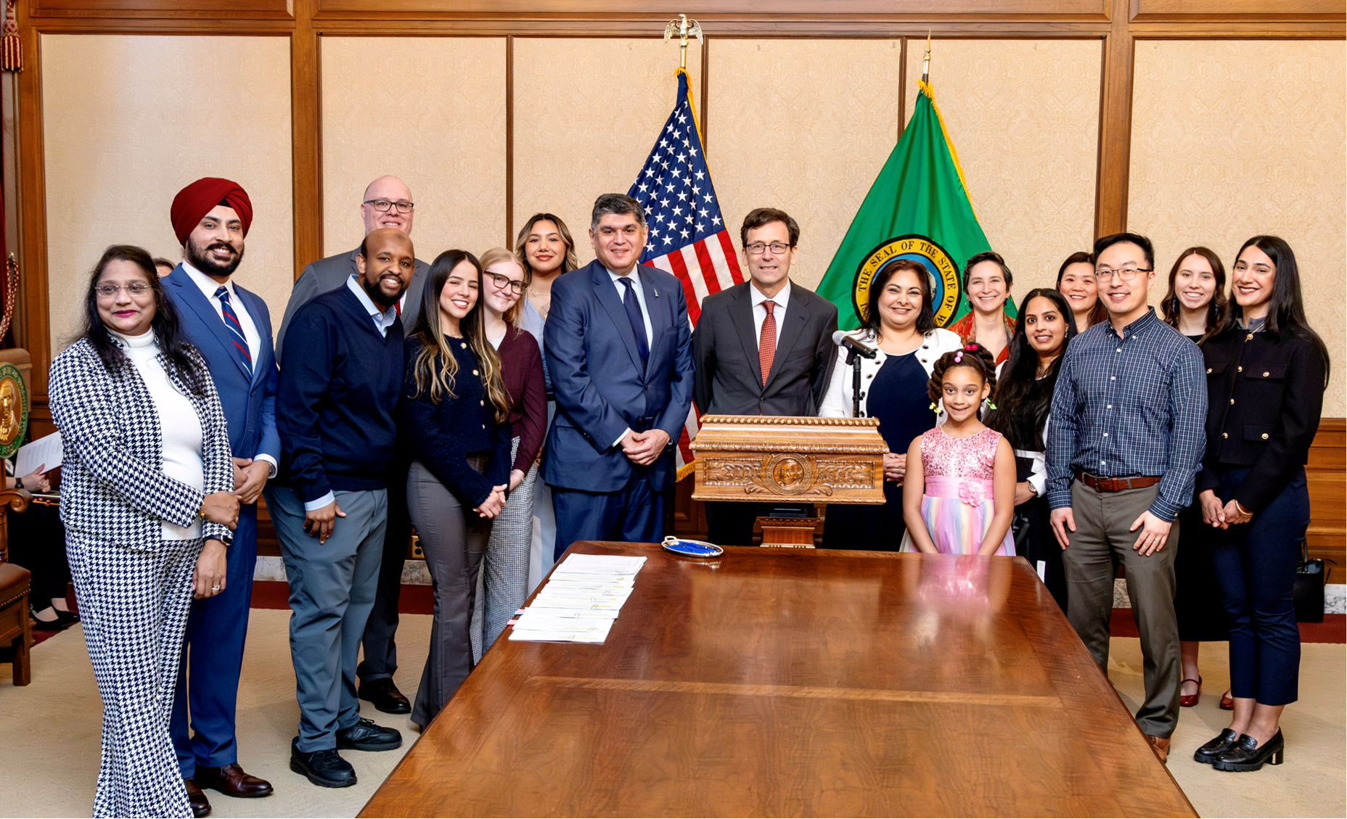
WMC Supported Legislation Passed
House Bill 1640
Senate Bill 5118
Notes:
Given that… we are still very proud of the important legislation that passed this year and thankful for our amazing staff that worked hard to get this legislation through the process.
Uniform Disciplinary Act technical fix, House Bill 1640. We identified some drafting errors that excluded the MD and PA compact from the UDA authority explicitly. This bill creates consistency by including these compacts into the UDA that governs the credentialing of health professionals.
Clinical Experience license update, Senate Bill 5118. This was an IMG workgroup developed bill and it removed the requirement for USMLE step 3 and Washington residency for 12 months before getting a license. It also added physician employment group as an option for nominating an individual for a license in addition to extending the total valid time for the license to eight years.

Slide 8
WMC Legislation Development Timeline
May:
  Identify issues
  Search for non-legislative solution
  Get feedback from interested parties
June:
  Brief executive committee on proposal
July:
  Get formal approval from WMC
August/September:
  More interested parties work
  Secure commitments of support
September/October:
  Submit proposals to Office of Financial Management (OFM) through DOH process.
November:
  Committee days
  Possible hearings, workshops, facilitated meetings
  OFM questions for response on our proposals
  Gather sponsor signatures
Notes:
Micah

Slide 9
WMC’s Budget and the Legislature
December:
  OFM approval and inclusion in the Governor's budget.
  If budget request, contact House and Senate fiscal staff and Chairs for notification and request inclusion in the House and Senate budgets.
  Get more signatures if legislation.
  If legislation, pre-file bill.
January:
  Legislative session begins.
  Governor's budget (including WMC ask) introduced.
  House and Senate budget (hopefully including WMC) introduced.
Notes:
Micah

Slide 10
WMC Budget Details (legislative)
Specific increased authority (2008)
Funds live in the “02G” or Health Professions Account
Must be legislatively appropriated and allotted for use per statute
Budget requests are called “decision packages”
  Maintenance & operations
  Increased case loads
  Policy/new programs
Typically used to increase spending authority only
Reliant on presence of a reserve above OFM mandate
Notes:
Micah

Slide 11
WMC Legislative Concepts for 2026
Non-disciplinary license relinquishment process
Protection of licensee personal and demographic information
Locums license type
Uniform Disciplinary Act updates
  Revocation standards
  Sexual misconduct clarification
  Skills assessment clarification
Medical Examiner authority clarification
Notes:
Some of these were proposed for 2025 but elected official transitions got them stuck in the process and as such, were not released in time to be considered.

Slide 12
Questions?
Clarifications?

Slide 13
Thank you
Micah Matthews
Deputy Executive and Legislative Director
Micah.Matthews@WMC.wa.gov
Stephanie Mason
Public Information Officer and Legislative Liaison
Stephanie.Mason@WMC.wa.gov

